Slide 1



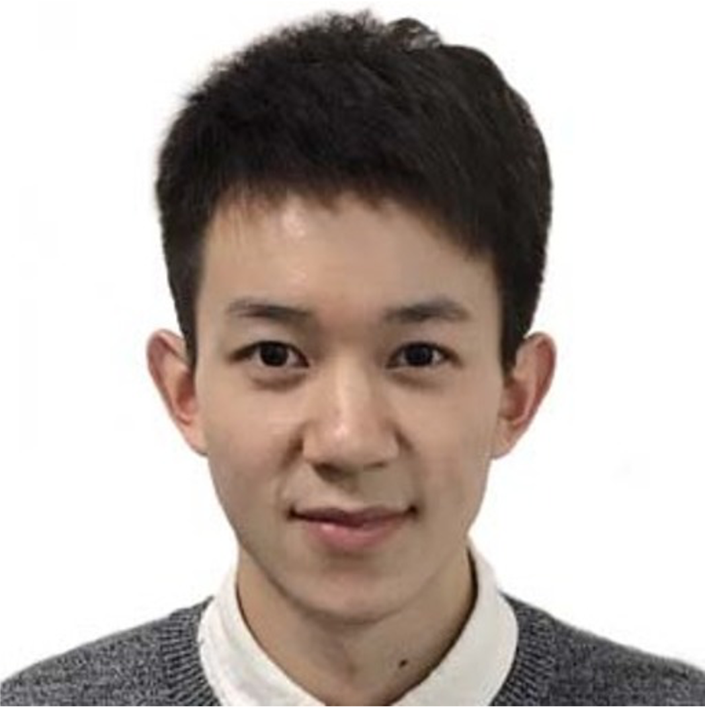

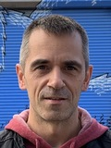

Conditional-Flow NeRF: Accurate 3D Modelling with Reliable Uncertainty Quantification
Project page: poetrywanderer.github.io/CF-NeRF/
Jianxiong Shen
Antonio Agudo
Francesc Moreno-Noguer
Adrià Ruiz
Notes:
We present Conditional-Flow NeRF: Accurate 3D Modelling with Reliable Uncertainty Quantification.

Slide 2
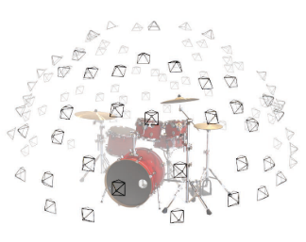
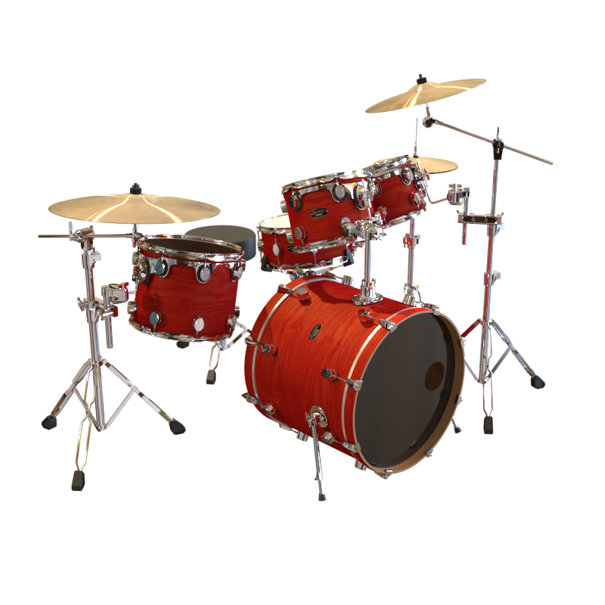
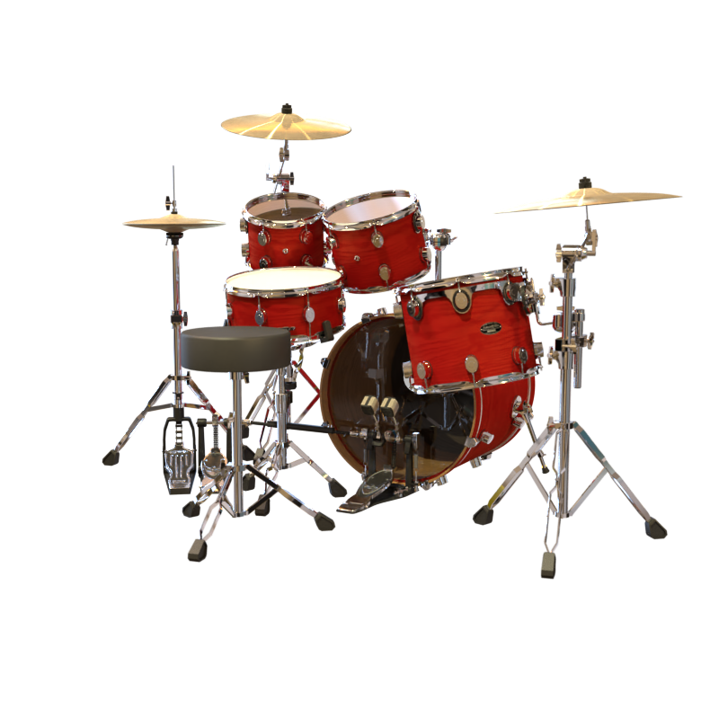
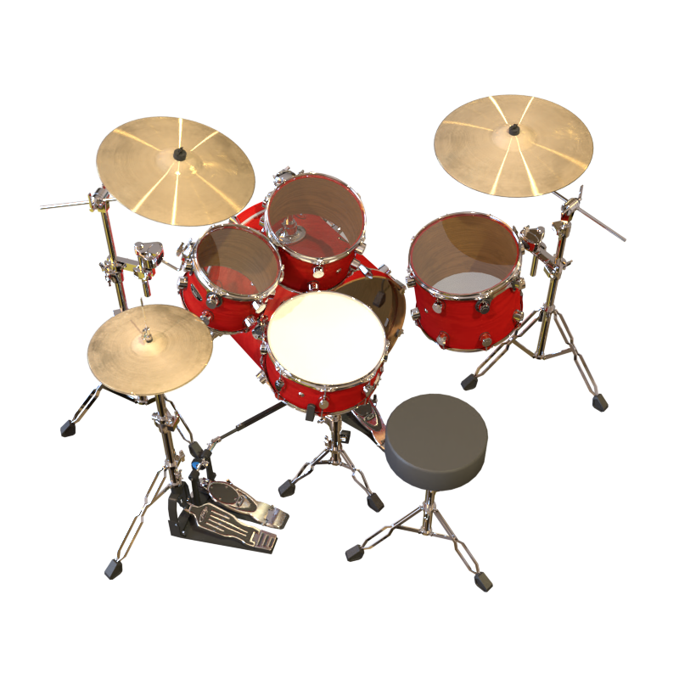
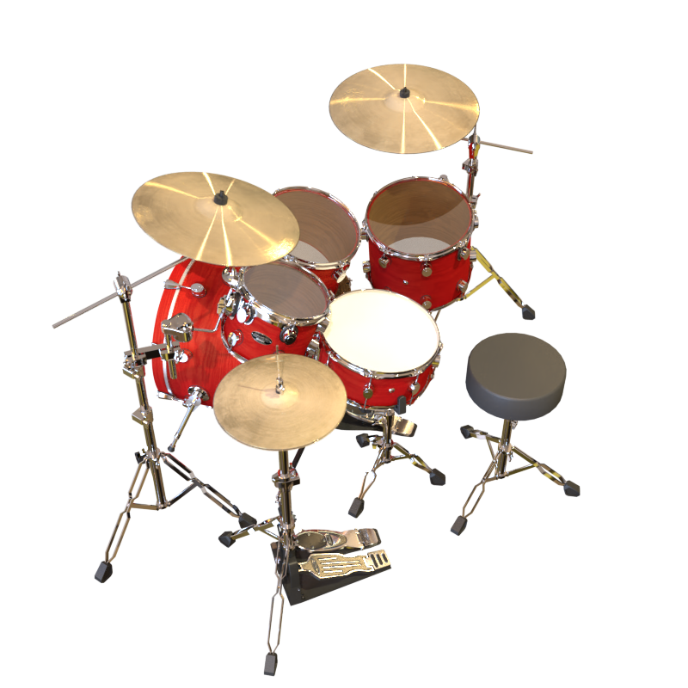
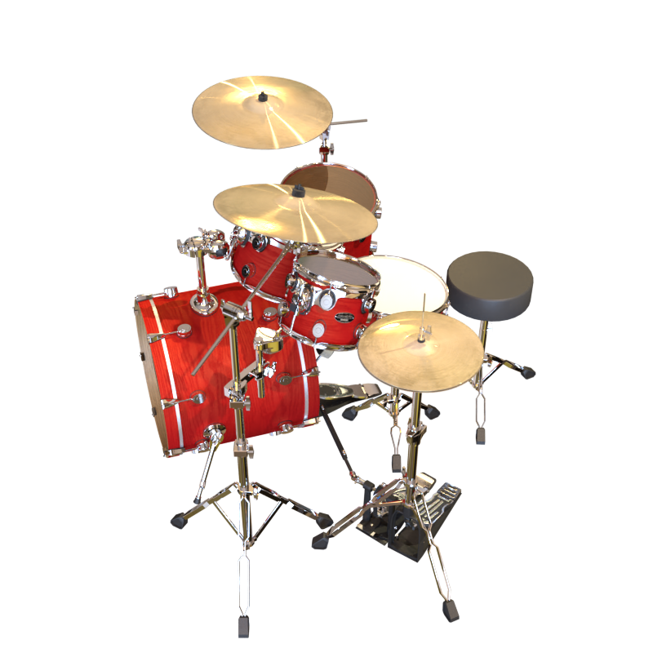
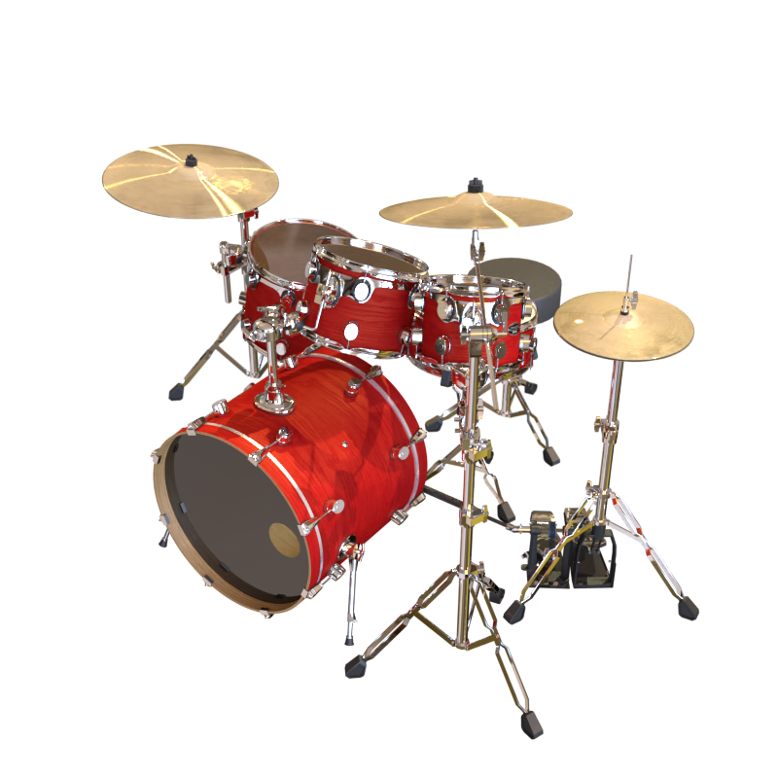
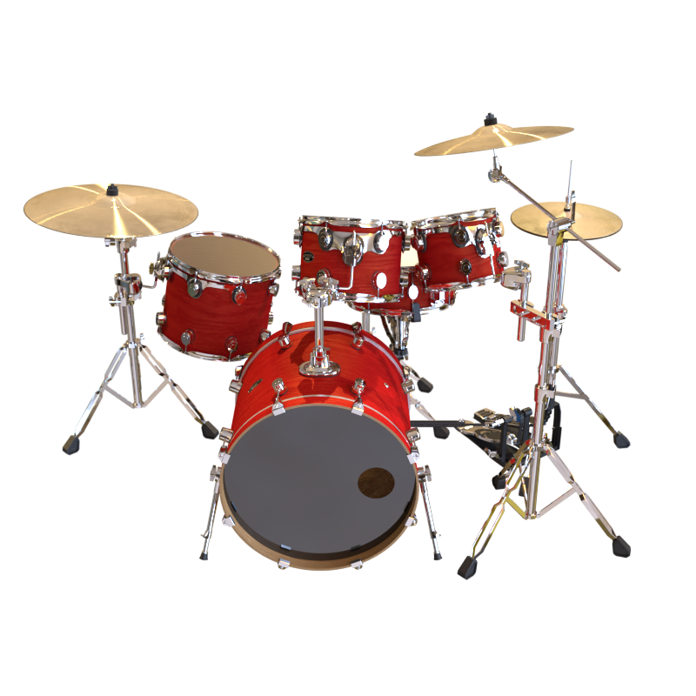
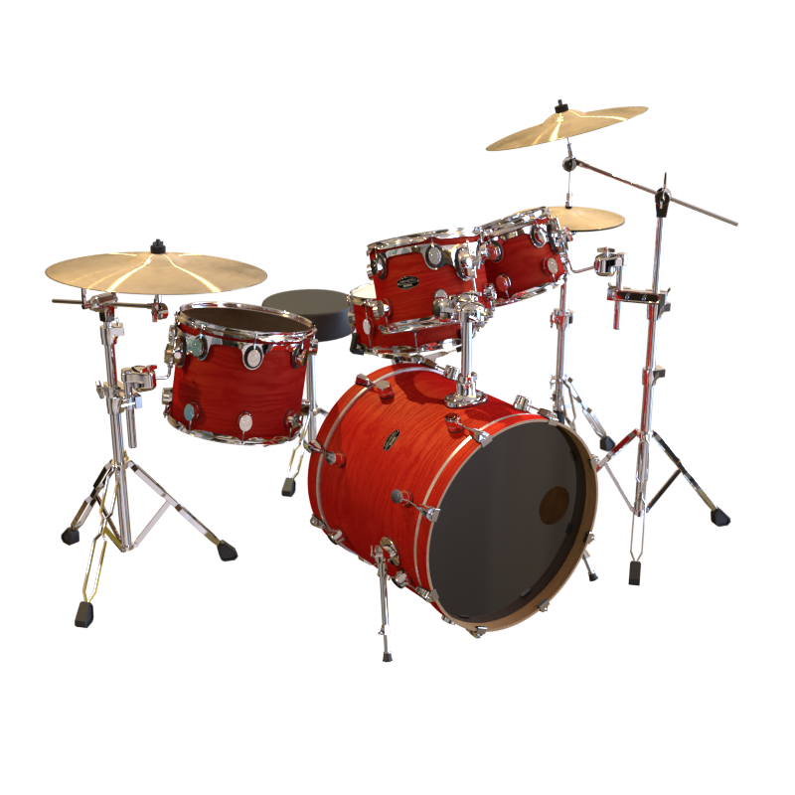
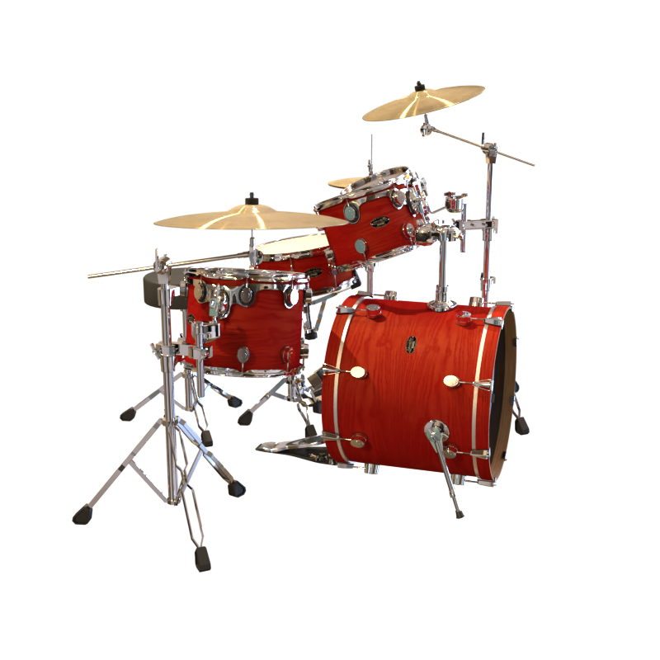
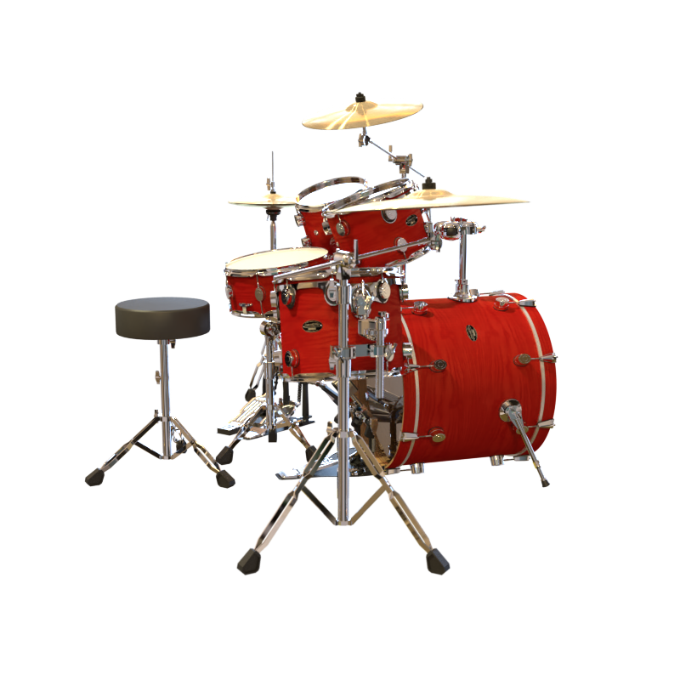
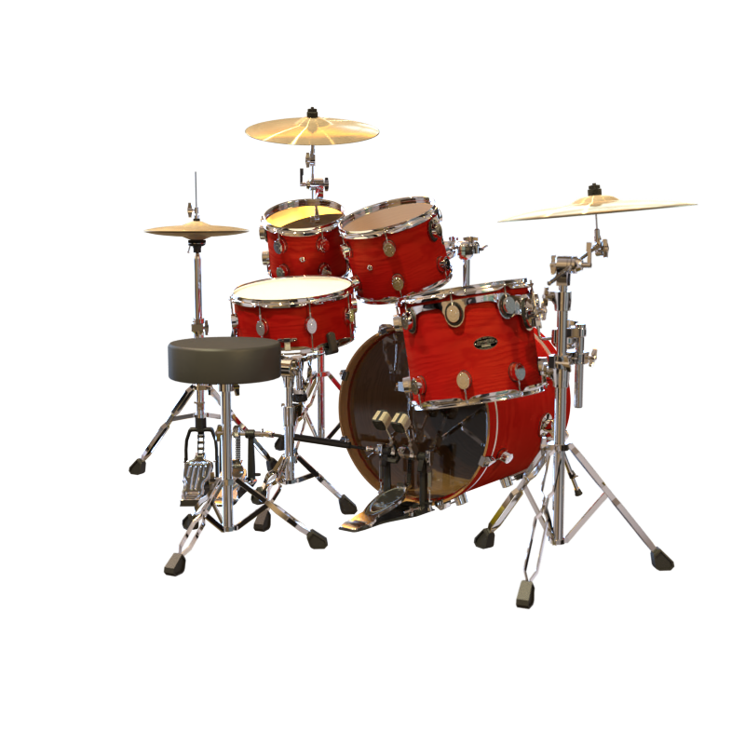
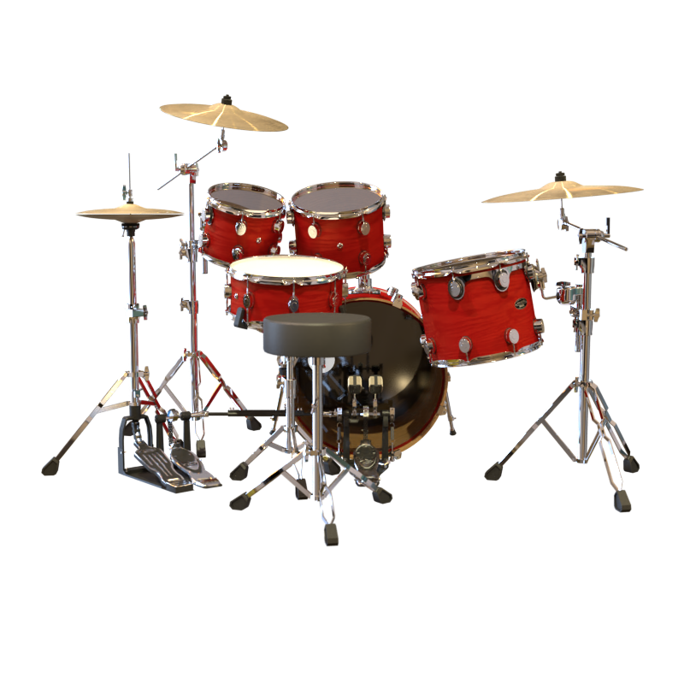
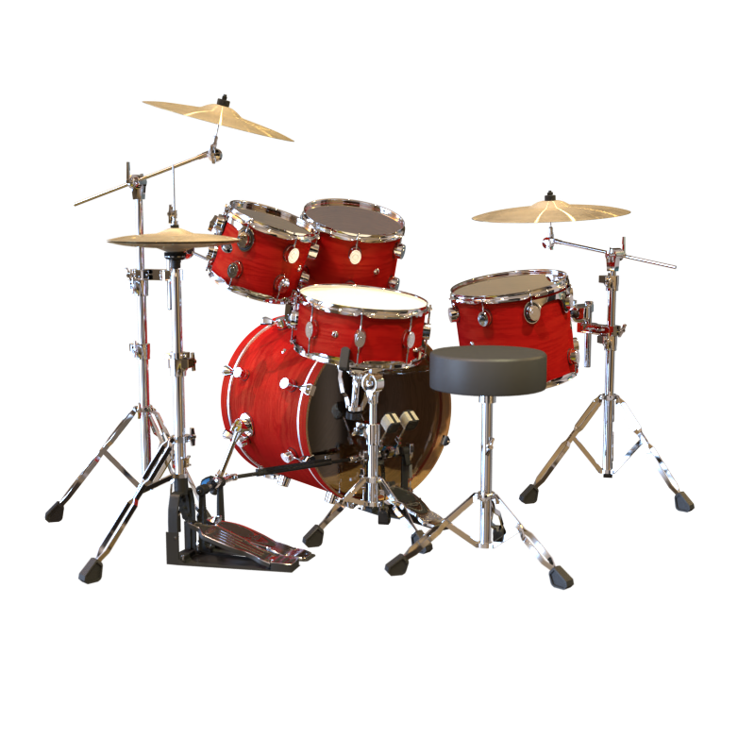
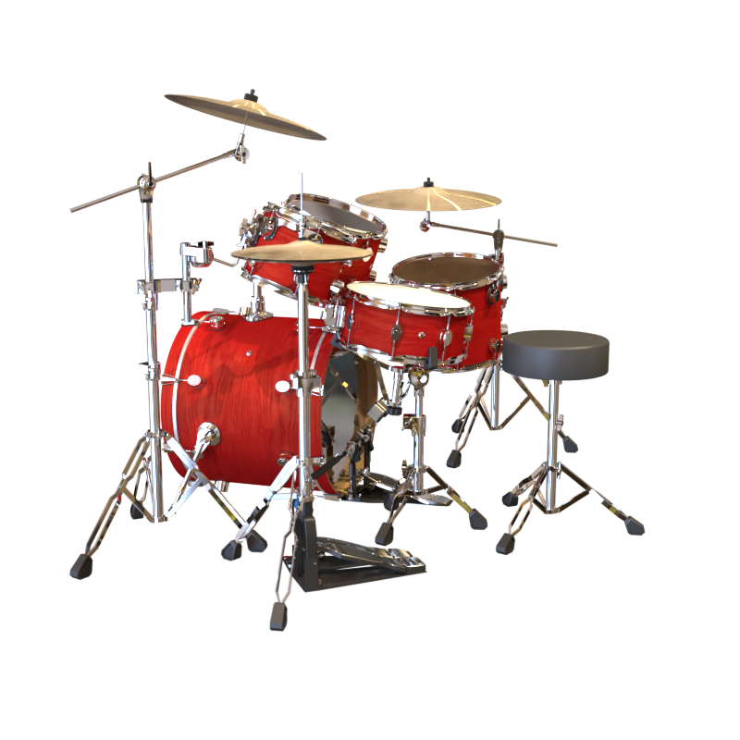
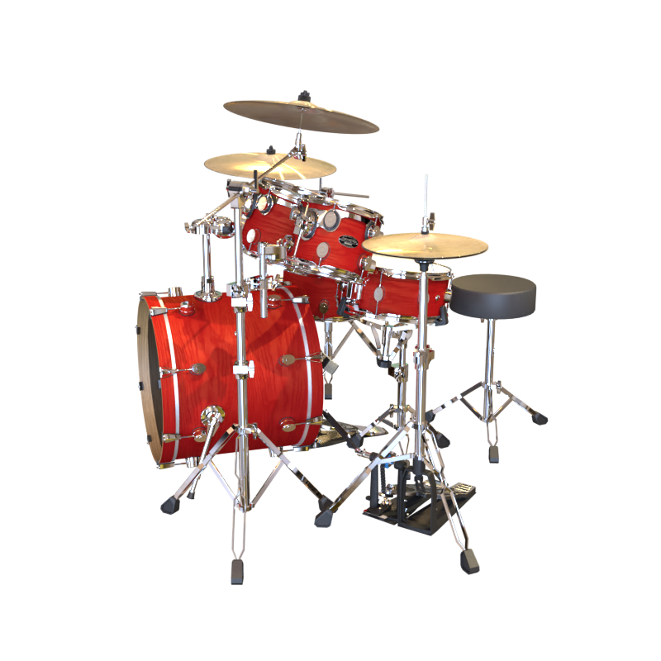
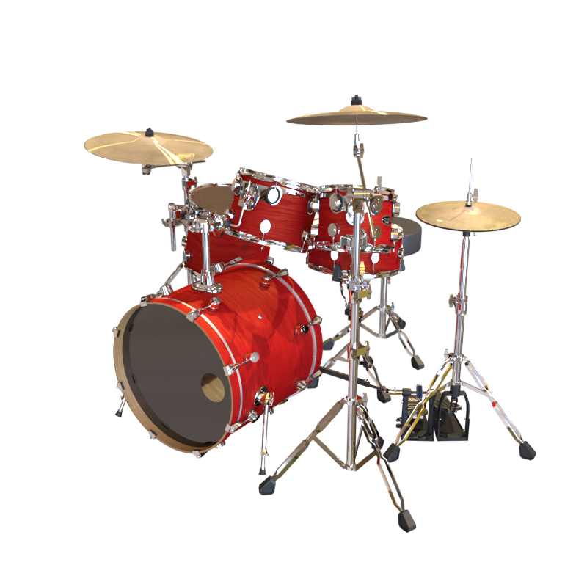
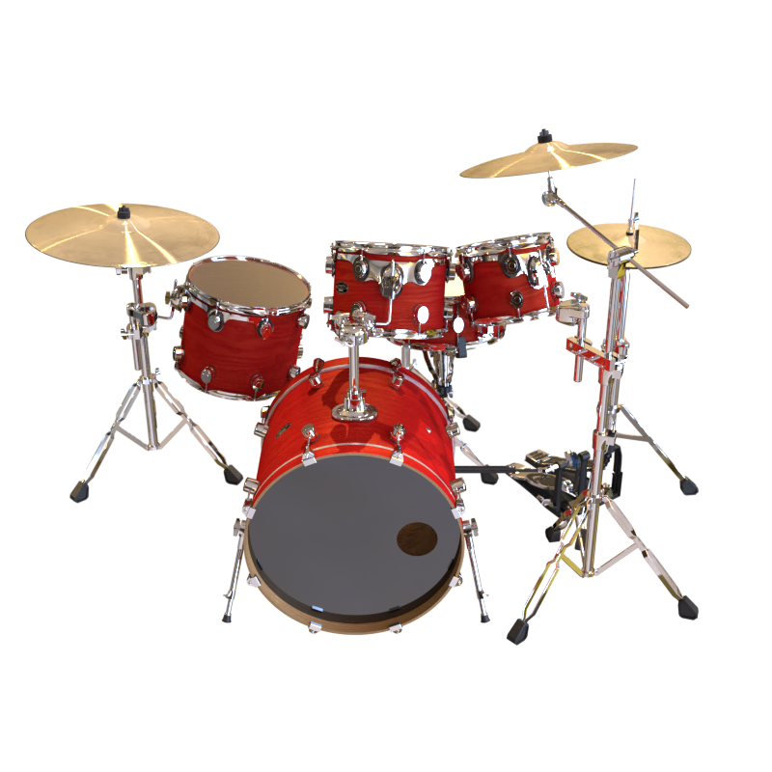
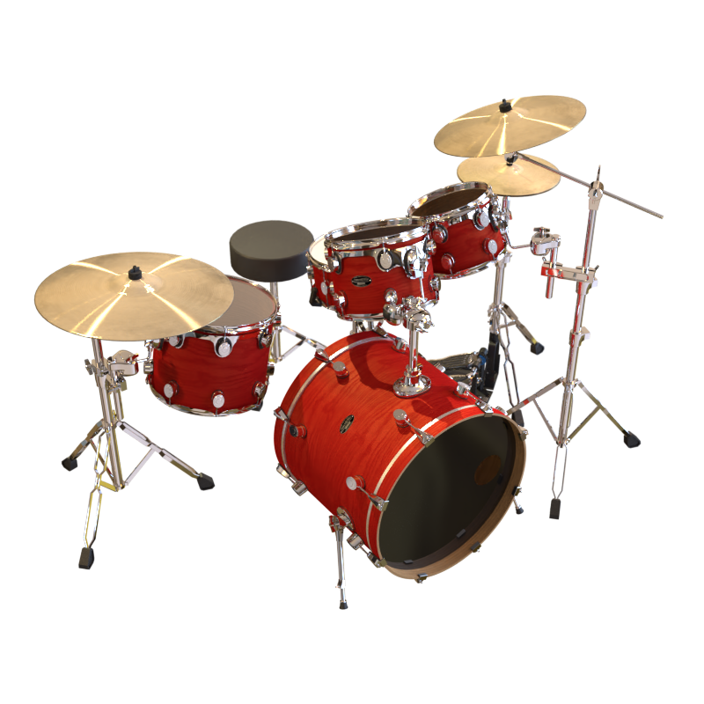
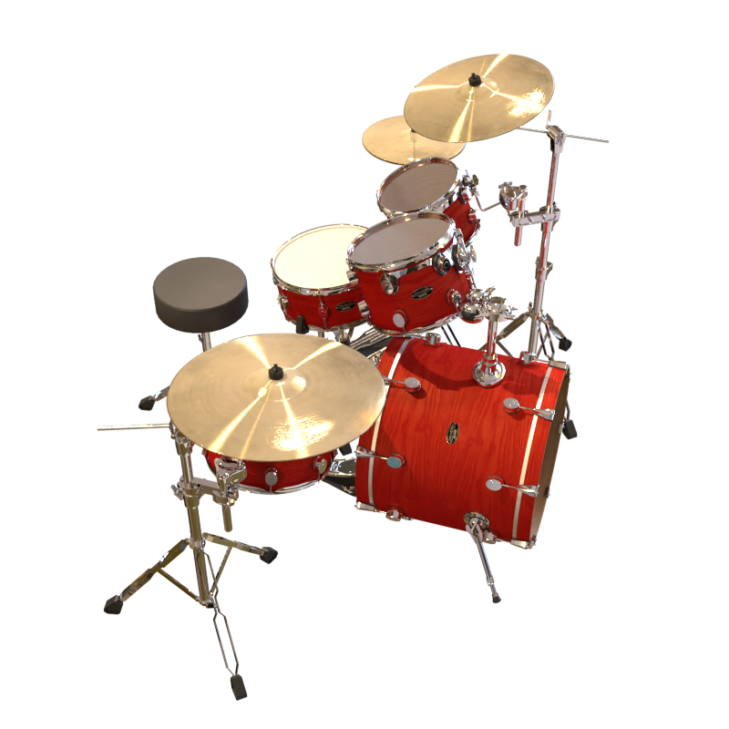
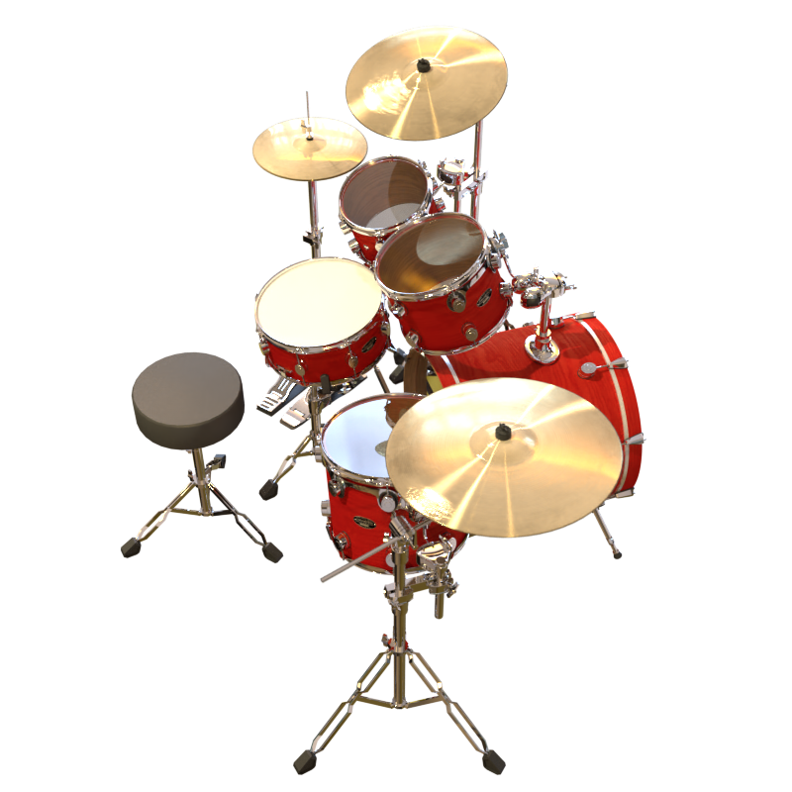
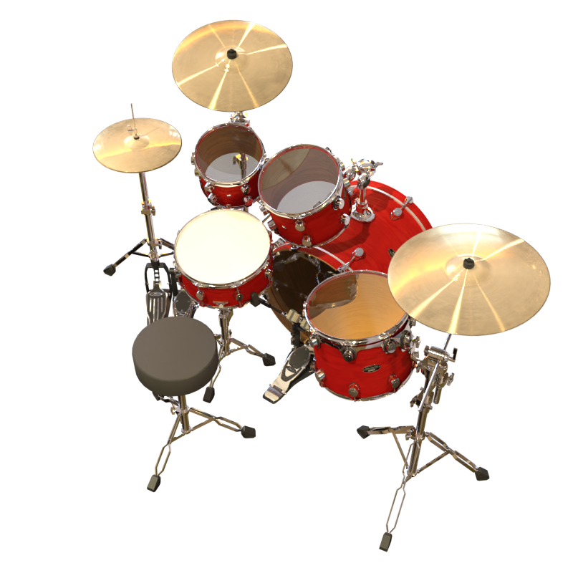
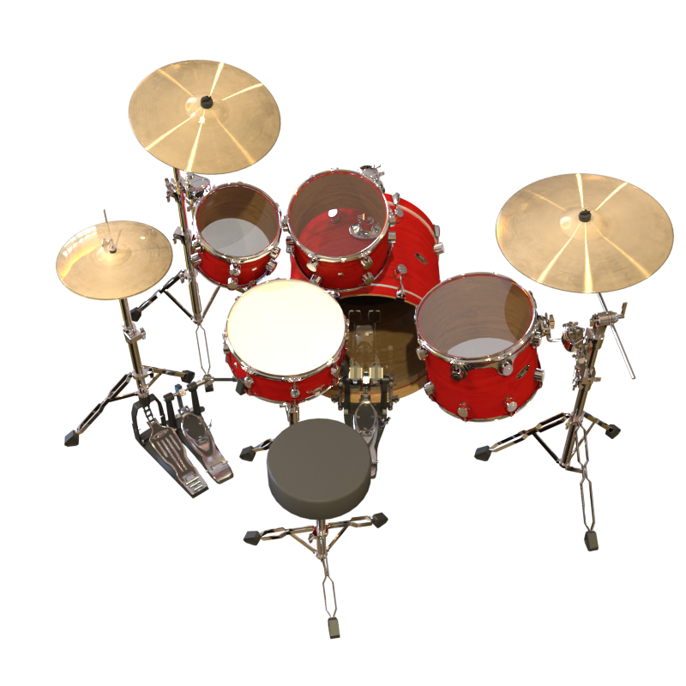
Novel View Synthesis by NeRF
NeRF (ECCV 20)
Dense input
Optimize NeRF
Render novel views
Notes:
Neural Radiance Fields (NeRF) have become a popular framework for novel-view synthesis. With dense input images, NeRF can render photo-realistic images from novel views.

Slide 3
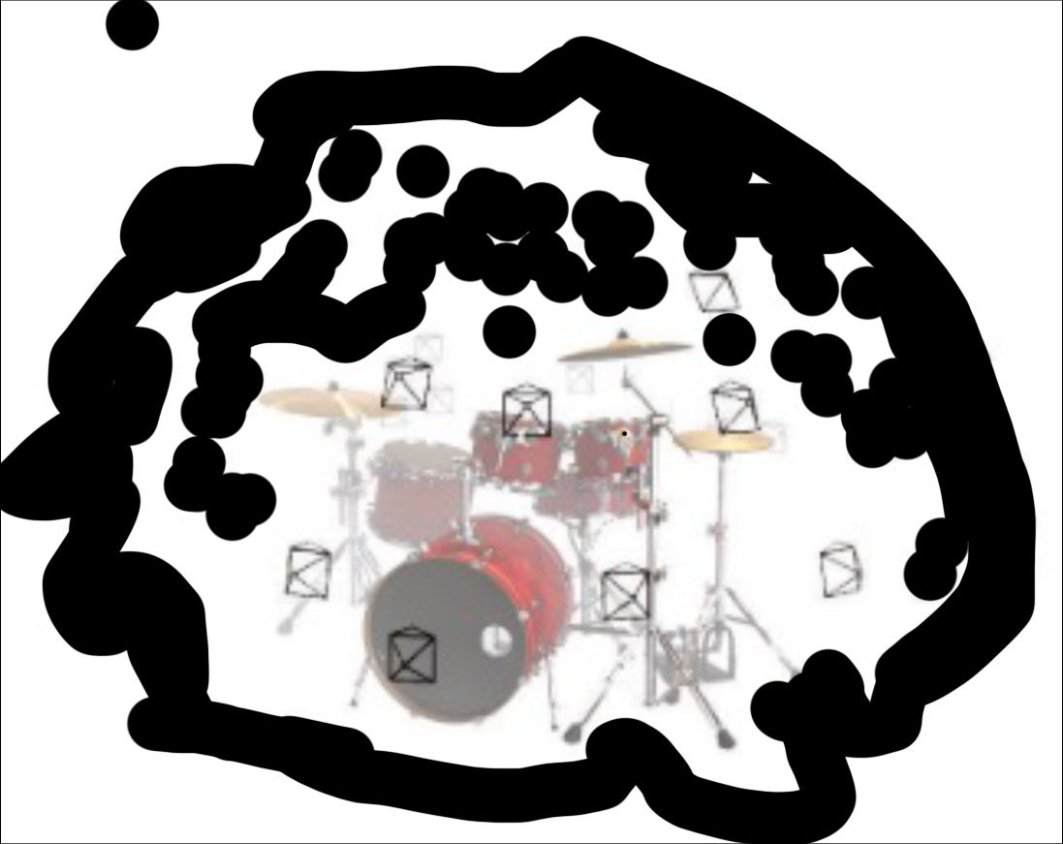

Novel View Synthesis by NeRF
NeRF (ECCV 20)
Sparse input
Optimize NeRF
Render novel views
Limitations:
Confidence?
No confidence information associated with the model outputs
Could make high-risk decisions based on the unreliable model estimations
Notes:
However, despite their impressive performance, they are unable to provide information about the confidence associated with the model outputs. In particular, when we cannot get enough input images, the model predictions might not be reliable and people could make high-risk decisions based on the model estimations.

Slide 4
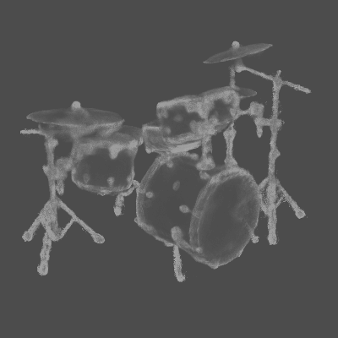
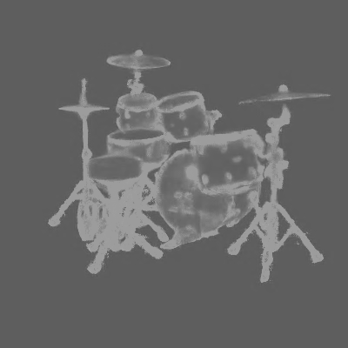
Novel View Synthesis by NeRF
NeRF (ECCV 20)
Sparse input
Optimize NeRF
Render novel views
High uncertainty
Confidence?
low uncertainty
Notes:
To solve this limitation, an intuitive way is to estimate the uncertainty associated with the model outputs.
This task aims to assign a value to each output such as pixel color, indicating how much the model is confident about this prediction.

Slide 5
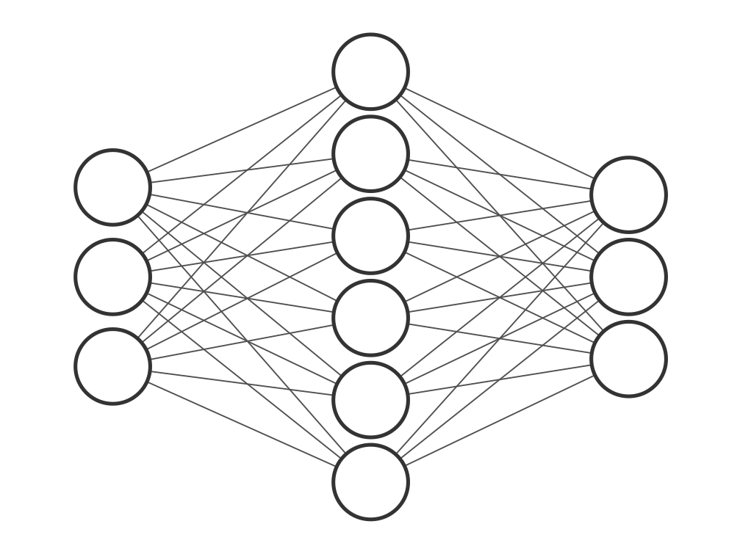
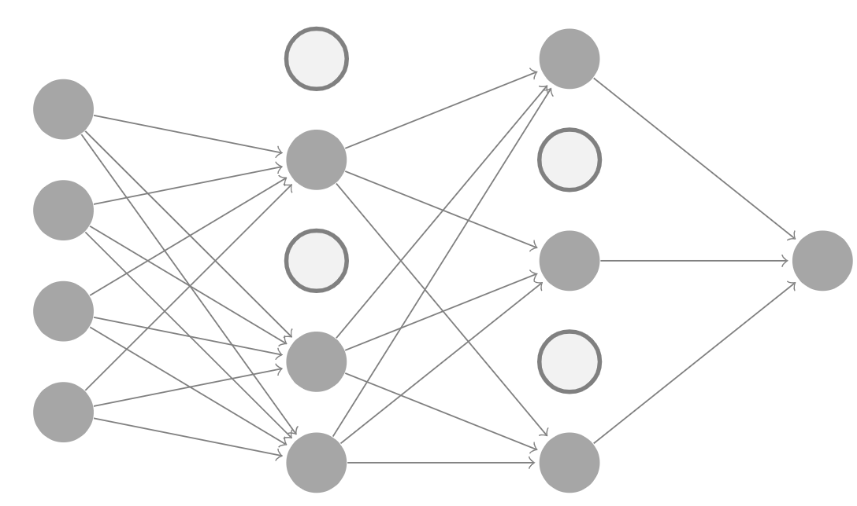
Uncertainty Estimation
Model agnostic methods
1. Deep Ensembles
N passes
…
Mean prediction
Uncertainty
N models
2. MC-Dropout
N passes
Single model
Notes:
Two popular model agnostic methods for general uncertainty estimation are deep ensembles and Monte Carlo-dropout. Using Deep ensembles, we need to train several models in parallel and then go through each of them to get mean predictions as well as associated uncertainty. With Monte Carlo-dropout. we need to add extra dropout layers, and then go through the model under different activated neurons to get the final estimations.

Slide 6
Uncertainty Estimation
 | Uncertainty | Models | Forward pass | Complexity | Continuous distribution
NeRF |  | 1 | 1 | O(1)
Deep Ensembles |  | N | N | O(N²)
MC-Dropout |  | 1 | N | O(N)
Ours |  | 1 | 1* | O(1*)
*only need to pass through the MLP once
Model agnostic methods are of high complexity in time and memory
Our method explicitly encodes a continuous distribution of the radiance fields into a single probabilistic model
Notes:
However, in contrast, these model agnostic methods are of more complexity in time and memory. Moreover, our method

Slide 7
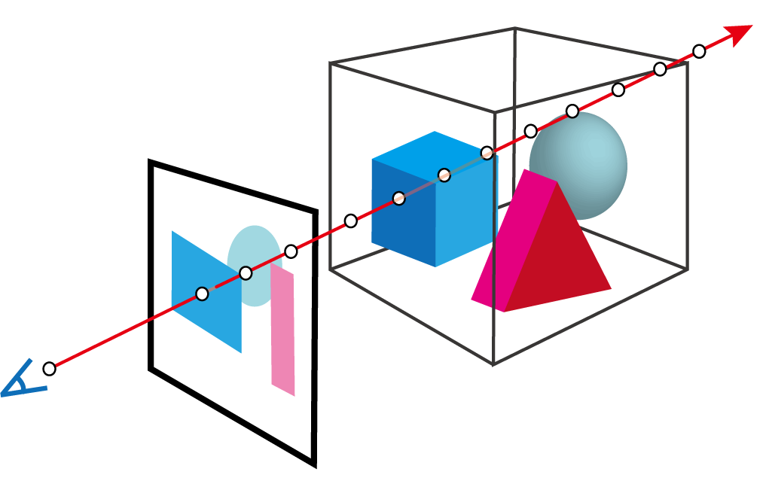
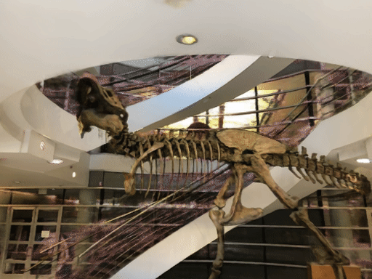
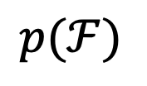
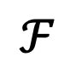
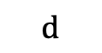
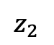
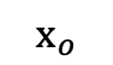
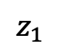
Deterministic vs. Stochastic NeRF
$$\text{d}$$
1. NeRF is deterministic
$$ℱ$$
MLP
$${\text{x}}_{o}$$
2. Our Conditional-Flow NeRF is stochastic
$$p(ℱ)$$
$$z_{1}$$
$$z_{2}$$
Notes:
In fact, the original NeRF method is deterministic. Which means, they can only learn a single radiance field with given input images. As a contrast, our conditional flow nerf is stochastic, which can model a continuous distribution over all possible radiance fields. By walking through the continuous distribution, we can observe the reasonable continuous color change in the rendered images.

Slide 8
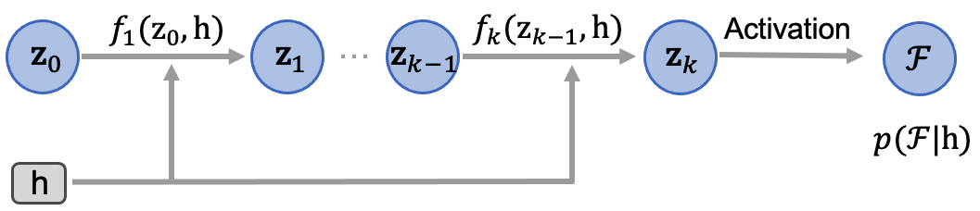
Conditional-Flow NeRF
Distribution Modelling with Normalizing Flows
allow for learning arbitrarily complex radiance and density distributions
Notes:
Specifically, we use normalizing flows to automatically model the distribution, which allows for learning arbitrarily complex radiance and density distributions.

Slide 9
Conditional-Flow NeRF
Global Latent Variable
Observation: changes in the radiance fields between adjacent locations are usually smooth
model the joint distribution over the radiance fields for all locations
Notes:
Secondly, based on the observation that changes in the radiance fields between adjacent locations are usually smooth, we incorporate a global latent variable to model the joint distribution over the radiance fields for all locations.

Slide 10
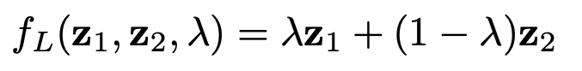

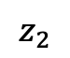
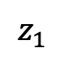
Conditional-Flow NeRF
Global Latent Variable
Interpolation results
$$z_{1}$$
$$z_{2}$$
S-NeRF (3DV 2021)
Ours
noisy and incoherent
smooth and coherent
Notes:
Then by interpolating from the latent variable, our methods can generate more coherent and smoothly changing frames. In contrast, the results of previous work S-NeRF are noisy and incoherent without considering the dependence among different 3D locations.

Slide 11
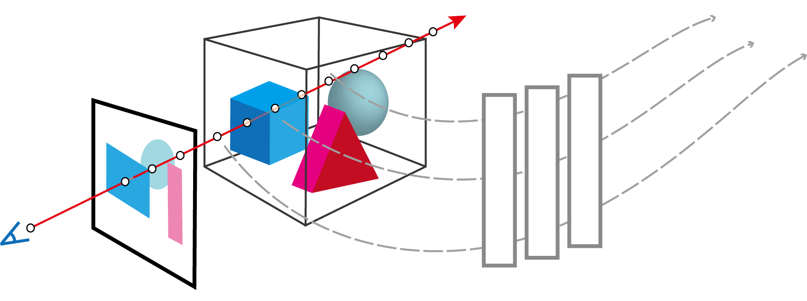
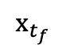
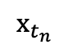
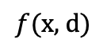
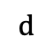
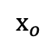
Architecture
(a) Encode coordinate feature
$${\text{x}}_{t_{f}}$$
$$\text{d}$$
$${\text{x}}_{t_{n}}$$
$${\text{x}}_{o}$$
$$f(\text{x}\text{, }\text{d})$$
Notes:
Then, I will illustrate the pipeline for the sampling and inference process. Firstly, like NeRF, we encode the coordinate feature through the original NeRF MLP.

Slide 12
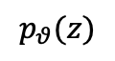
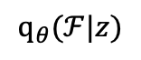
Architecture
(a) Encode coordinate feature
(b) Distribution Modelling by CNF
global prior
$$p_{θ}(z)$$
$${\text{q}}_{θ}(ℱ|z)$$
CNF
$${\text{x}}_{t_{f}}$$
$$\text{d}$$
$${\text{x}}_{t_{n}}$$
$${\text{x}}_{o}$$
$$f(\text{x}\text{, }\text{d})$$
Notes:
Then, we can sample a set of variables z from the global prior, and then go through the conditional normalizing flow to model a distribution over all possible radiance fields.

Slide 13





Architecture
(a) Encode coordinate feature
(b) Distribution Modelling by CNF
(c) Rendering and Optimization
$$ℒ_{\text{NLL}}=\frac{1}{N}\sum_{n=1}^{N}{\log{p}({\text{C}}_{n}|ℱ)}$$
global prior
$$p_{θ}(z)$$
$${\text{q}}_{θ}(ℱ|z)$$
CNF
$${\text{x}}_{t_{f}}$$
$$\text{d}$$
Pixel-color likelihood
$${\text{x}}_{t_{n}}$$
$$α$$
$${\text{x}}_{o}$$
$$f(\text{x}\text{, }\text{d})$$
Volume Rendering
$$t_{n}$$
$$t_{f}$$
possible trajectories
Notes:
Next, from the learned distribution, a set of different density-radiance trajectories along each ray can be acquired, followed by volume rendering to composite each trajectory into a RGB value.
Finally, we directly optimize the log-likelihood for the pixel color.

Slide 14

Results Comparison:
*Average results over LF dataset
Notes:
Now, I will show you some results compared to previous methods including several SOTA approaches. From the quantitative results, we can see that our method can achieve the best performance both on RGB and Depth predictions across the quality and uncertainty metrics.

Slide 15
















Results Comparison:
on RGB image
Deep Ensembles
MC-Dropout
NeRF-W (CVPR 21)
S-NeRF (3DV 21)
Ours
RGB Pred.
PNSR
25.93
24.00
19.81
23.56
26.39
Pred. Error
Correlation
NLL
1.26
1.35
2.23
0.26
- 0.90
Uncertainty
map
Notes:
From the qualitative results, we can see that our method can generate more accurate predictions with higher PSNR. At the same time, our estimated uncertainty map is visually highly correlated with the true prediction error, shown by lower NLL, compared to the previous methods.

Slide 16














Results Comparison:
on Depth map
Deep Ensembles
MC-Dropout
NeRF-W (CVPR 21)
S-NeRF (3DV 21)
Ours
Depth Pred.
RMSE
0.221
0.241
0.214
0.417
0.166
Pred. Error
Correlation
NLL
7.88
10.96
-
8.75
6.76
Uncertainty
map
Notes:
Moreover, on depth map, our method can also achieve reasonable uncertainty estimation associated with the prediction error, as well as more accurate depth predictions.

Slide 17

Time Performance
Accuracy (PSNR )
Uncertainty (NLL )
Limitations:
Although reasonable at inference, the training process is still quite slow because of the implicit MLP structure
Notes:
As for time performance. It can be observed that our method performs the best both on image quality (PSNR) and uncertainty estimation (NLL) with a reasonable inference time compared to all the baselines. Moreover, properly reducing the number of samples during inference (K=8∼16) dramatically reduces the inference time with a negligible impact on performance. However, ..

Slide 18



Follow-up Work
To further reduce the time usage, our framework is general enough to be readily integrated into other efficient NeRF variants like Voxel-based* instead of MLP.
$$\text{d}$$
global prior
$$p(z)$$
query
CNF₁
V^{(grid field)}
$${\text{x}}_{o}$$
*Direct voxel grid optimization. In CVPR, 2022 (DirectVoxGO)
Notes:
To future ..

Slide 19

Conditional-Flow NeRF: Accurate 3D Modelling with Reliable Uncertainty Quantification
Project page: poetrywanderer.github.io/CF-NeRF/
Notes:
More details about our work can be found on our project website.

